Slide 2

#1
Do you prefer
Online Shopping ?
1. Yes 2. No

Slide 3








Online Shopping
#2
Online shopping has an annual growth rate of 23% worldwide*
In Sri Lanka, online shopping is a fast growing industry now.
* http://www.nielsen.com/lk/en/insights/news/2017/a-look-at-the-evolving-e-commerce-landscape.html

Slide 4

What are the issues ?
#3

Slide 5

Q-Trace
#4
Smart Parcel Tracking Service

Slide 6

#5
May, 1840
https://www.kenmorestamp.com/worlds-first-stamp

Slide 7

#6
QR Stamp

Slide 8
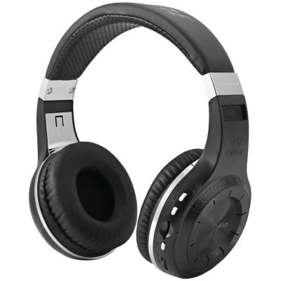
#7
Just imagine
You brought an Item from an ‘Online Store’

Slide 9
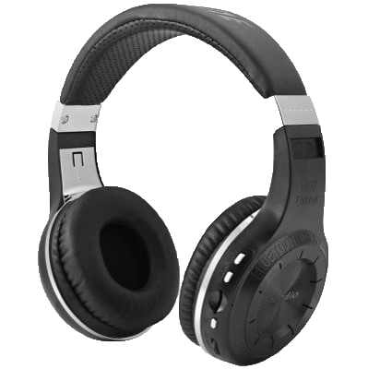


#8
Seller needs to send it to you
through a courier company.

Slide 10

#9
Receiver’s Name
House Number,
Street,
Town
ABC-12345678-D

Slide 11
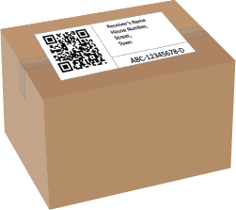
#10
Labeled the package with QR Code + Address

Slide 12
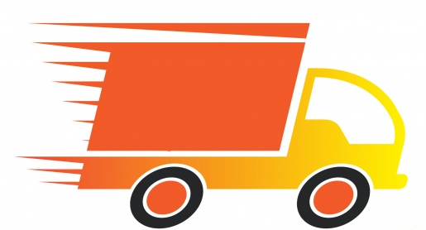
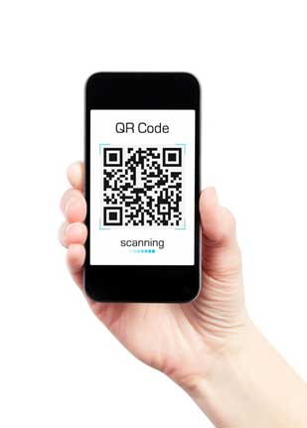
#11
In each exchange point,
Delivery person should scan the QR code

Slide 13

#12
Delivery agents can be monitored
using GPS Tracking

Slide 14
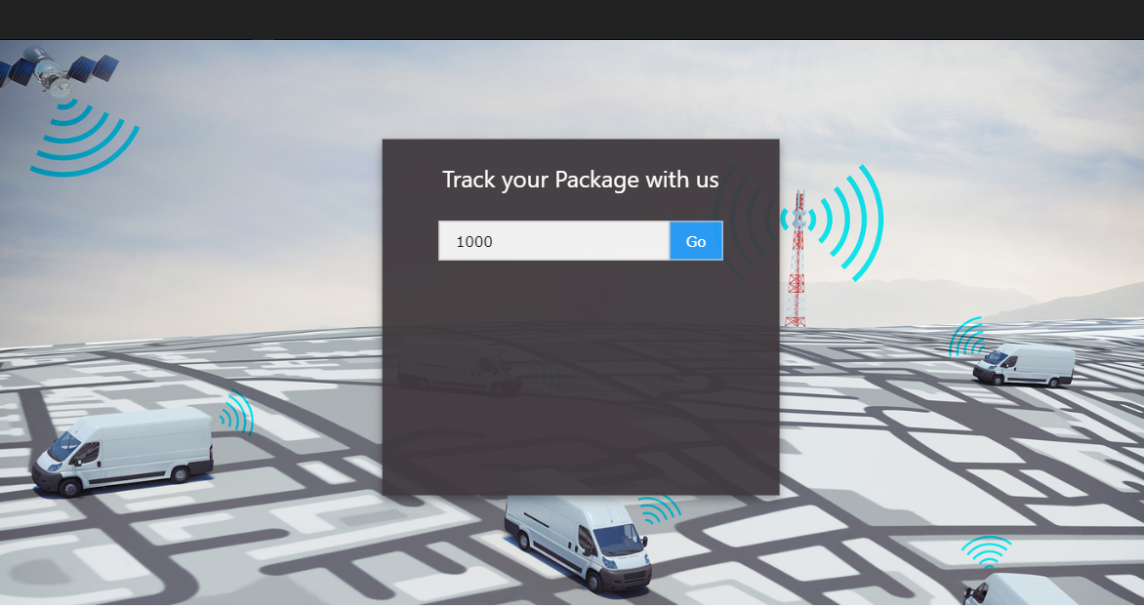
#13
Buyers can track their parcels
ABC-12345678-D

Slide 15

#14
What are the advantages ?
Reliability
- Always there is a person with responsibility.
- Can avoid parcel lost.
Transparent service for both sellers and buyers
Dynamic Destination Address
- Buyer can update their location while the parcel in delivery.*
No additional hardware requirements – Easy to setup

Slide 16

How revenue generates ?
#15
API Market
We will release our platform as Web APIs. (Application Programming Interface)
Any selling, delivery company can register with these APIs and take the advantages of our platform.
Charging per number of API requests.
Technical support
We can provide technical support to these companies.
Integrate our platform with mobile apps, websites etc…

Slide 17


Slide 18


Slide 20
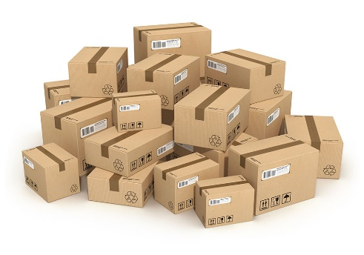



Index
#17
#18
#19
#20

Slide 21




#17

Slide 22

Feature Improvements
#18
Dynamic Destination Addresses
Clients can change their address while the parcel/package in delivery
Can add rules for the destination address
Provide Cash on Delivery Service
The client can pay using his/her bank account through the app.
The mobile app can analyze its previous data and correctly estimate a high precision delivery time from one location to other.
GPS enabled tracking device for delivery vehicles.

Slide 23




Technologies will be used
#19
HTML, JavaScript (jQuery) & CSS for frontend development
PHP, MySQL for backend development
HTTP Restful APIs (JSON)
Apache Cordova for Mobile App Development
(Supports hybrid mobile app development; Android, Windows & iOS )

Slide 24
What will be done in the Hackathon?
#20
Develop the essential platform futures
qTrace Deliver App
qTrace Parcel Tracking Site
IoT based tracking device

Slide 25
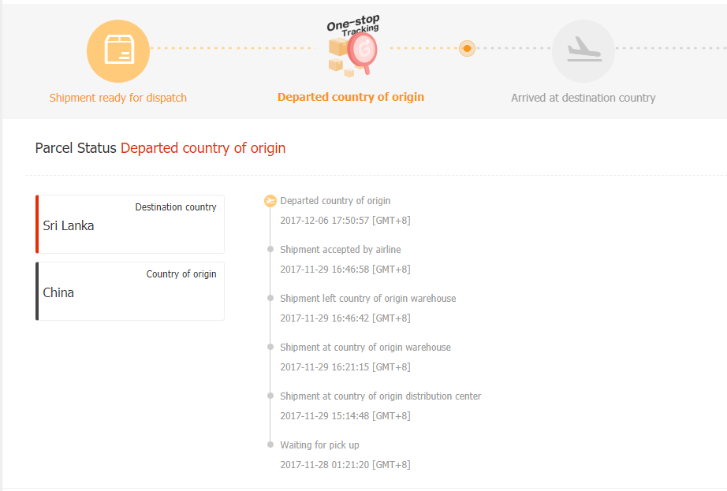
#21

Slide 26
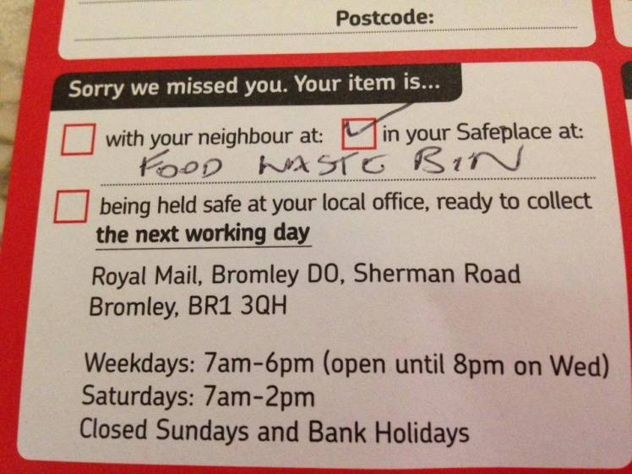
#22

